Slide 1
CSCI-1620
Recursion I

Slide 2
Recursion
We’ve seen cases of methods calling upon other methods
  This ability is required since main itself is a method
It is also possible for a method to call upon itself
This can be used to solve a more difficult problem that can be broken up into one or more similar, smaller problems

Slide 3
Recursion
A method that calls upon itself is called a recursive method
This can be done directly or through another method
  Method A calls on Method B which calls on Method A
  Though A doesn’t directly call upon A it is still considered recursive

Slide 4
Recursion
The obvious risk of this is for the continuous calling of a method upon itself to never end
This technique requires the problem to be approached in a certain way
The problem must be broken down into two different types of cases
  Base cases – those versions of the problem where the answer is known
  General cases – those versions of the problem where the answer is not known

Slide 5
Recursion
The base case(s) is the stopping point of the recursion
Once the base case is reached, since it is the simplest form of the problem no further recursive calls are made
At this point the base case answer is returned and the unresolved calls of the method are worked out in the reverse order they were called

Slide 6
Recursion
The general case(s) represents a form of the problem for which the answer is not known, however this version of the problem can be restated in such a way that it requires the answer to a smaller version of the same problem

Slide 7
Terminology
Base case The case for which the solution can be stated non-recursively (solution is known)
General (recursive) case The case for which the solution is expressed in terms of a smaller version of itself
Recursive algorithm A solution that is expressed in terms of:
  (a) smaller instances of itself and
  (b) a base case

Slide 8
General Format of Recursion
if (some condition for which answer is known)
solution statement, return known answer // base case
else // general case
recursive method call, break the problem down into a smaller version of the same problem, return answer

Slide 9
Example: Factorial
A factorial, which is of the form n! multiplies n by all other numbers less than it greater than or equal to 1
n! = n * n-1 * n-2 * n -3 … * 1
5! = 5 * 4 * 3 * 2 * 1
How can a factorial be split into a simpler case?
What is the base case?
How can we write a method for this?

Slide 10
Example: Powers
Another common problem that can be broken down into a recursive solution is taking a base to a power
How can this be split into a simpler case?
What is the base case?
What is the general case?

Slide 11
Base-Case Question: Is there a non-recursive way out of the method?
Smaller-Caller Question: Does each recursive method call involve a smaller case of the original problem leading to the base case?
General-Case Question: Assuming each recursive call works correctly, does the whole method work correctly?

Slide 12
Example
public static int method(int a, int b)
{
if ( b == 0 ) // base case
return 0;
else if ( b > 0 ) // first general case
return a + method( a , b - 1) ;
else // second general case
return method( - a , - b ) ;
}
What will be stored in ‘x’ after the following 3 function calls are executed?
method(5, 2);
method( - 5, - 2 );
method( 5, - 2 );

Slide 13
Example
Call 1: method(5, 2);
Call 2: return 5 + method(5,1);
Call 3: return 5 + method(5,0);
Call 4: return 0
Final result: 10

Slide 14
Example
Call 1: method( - 5, - 2 );
Call 2: return method(5,2);
  Signs of original parameters are flipped
Same call trace as shown in previous slide
Final Result = 10

Slide 15
Example
Call 1: method( 5, - 2 );
Call 2: return method(-5, 2);
Signs of original parameters are flipped
Call 3: return -5 + method(-5, 1);
Call 4: return -5 + method(-5,0);
Call 5: return 0
Final result: -10

Slide 16
Example
What about this solution?
public int method (int a, int b)
{
if (b == 1)
return a;
else
return a + method(a, b-1);
}

Slide 17
Example
This solution would lead to infinite recursion for b < 0
It only works on a limited amount of cases
This solution would easily be converted into an iterative approach, but not fully functional

Slide 18
Example: Fibonacci Series
A number in the Fibonacci Series can be expressed by
fibonacci(n) = fibonacci(n-1) + fibonacci(n-2)
This is an obvious case for recursion
What are the base cases?
How can we write a method for this?

Slide 19
Example: Fibonacci Series
Warning for recursive calls
Each method call takes time, which can be a problem if efficiency is a concern
The example of the Fibonacci Series is a very work intensive solution
Each non base case call makes two recursive calls, which in turn make two and so on
Many of these calls are repeats of calls already made
Calculating the 20th Fibonacci value will require 21,891 method calls
The 30th requiring 2,692,537
The real issue here isn’t just making multiple recursive calls, but that the same calls are being made many times

Slide 20
Method Stack
When methods call upon methods they are resolved based on a stack structure
The stack structure implements the idea of Last In First Out (LIFO)
The last item placed on the stack is the next one to be considered

Slide 21
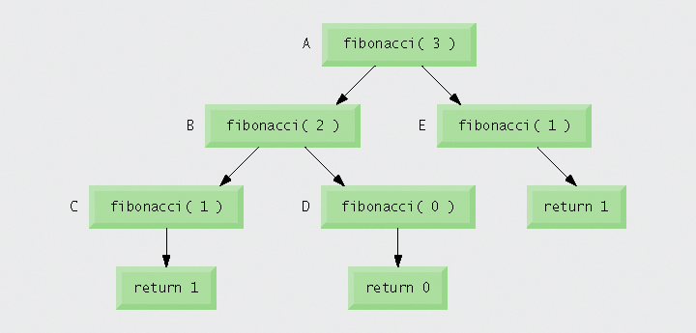
Fibonacci Call Order

Slide 22
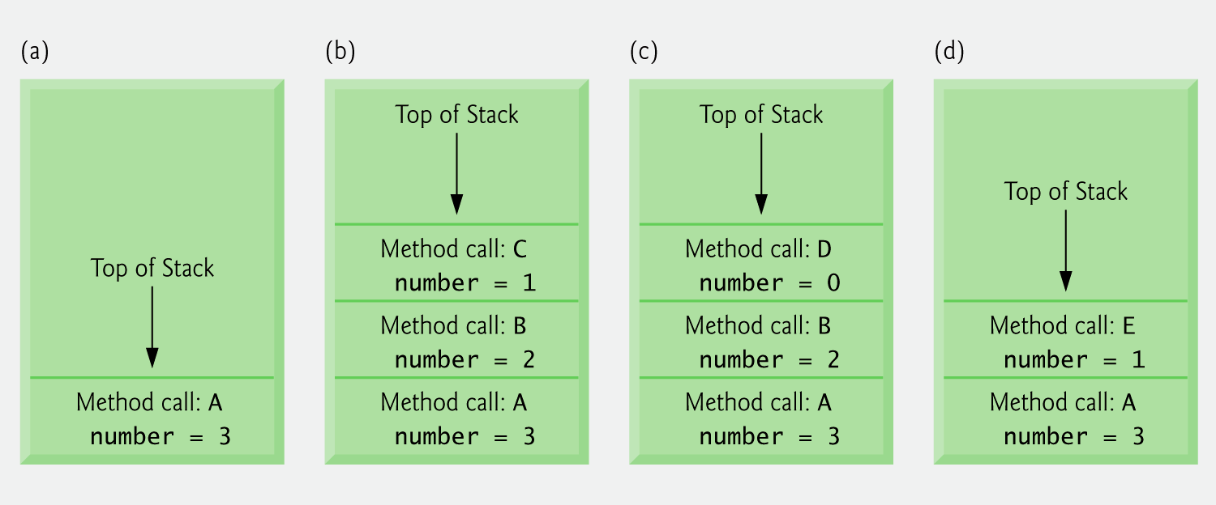
Fibonacci Call Resolution

Slide 23
Recursion vs. Iteration
All of the recursive examples we’ve seen could also be solved with iteration
Both are based upon a control structure
  Iteration: Looping
  Recursion: Decision
Both are terminated based upon a condition
They are different ways of performing repetition

Slide 24
Recursion vs. Iteration
Poorly planned Recursion and Iteration can suffer from the same problem of infinite repetition
  Iteration: Condition never becomes false
  Recursion: No base case is reached

Slide 25
Recursion vs. Iteration
Recursion can takes up considerably more resources than iteration
  Time
  Memory
Each method call takes time
Each copy of the recursive method creates new instances of its parameters

Slide 26
Recursion vs. Iteration
Any problem that can be solved with recursion can be solved with iteration and vice-versa
  There are some languages (Functional Languages) that do not implement looping structures such as for and while, they only implement the ability of recursion
  These languages are thought to be mostly academic, though mathematically equivalent
Why use recursion?

Slide 27
Recursion vs. Iteration
The recursive approach may be more intuitive for a given problem
Though an iterative solution is possible, it may be more complex or not immediately apparent
Recursive solutions may require less code and easier to debug and maintain
However, recursion should be avoided in situations where performance is a high priority

Slide 28
Consider Recursion When:
The depth of recursive calls is relatively “shallow” compared to the size of the problem.
The recursive version does about the same amount of work as the non-recursive version.
The recursive version is shorter and simpler than the non-recursive solution.

Slide 29
Recursive Backtracking
So far our recursive examples have been of the form
  Base Case – return base value
  General Case – recursive call
Now a look at recursion, not to calculate the answer to a dissectible problem, rather to make decisions and be able to return to previous decisions

Slide 30
Recursive Backtracking
Think of the idea of traversing a maze of squares
At each square you can potentially move up, down, left, or right
However, if a dead end is eventually reached you will need to back up to a previous decision and try an alternate route

Slide 31
Recursive Backtracking
Recall that method calls are resolved in reverse order, so returning from the last method call will bring you back to the “decision” made previously
From this point choose another path

Slide 32
Recursive Backtracking
Recursive Backtracking – process of using recursion to return to earlier decision point
If one set of recursive calls does not result in solution, program backs up to previous decision point and makes different decision, often resulting in another set of recursive calls

